Slide 1
Sanchez Electronic Devices
Dawn Lockett, Shivani Trivedi

Slide 2
Definitions
Specialization-to produce those goods and services which you can make most efficiently and with the greatest cost advantage
Import-to sell goods or services made in other countries in your home country
Export-to sell goods or services to foreign markets
Exchange rate-the comparative value of two currencies or in other words how much one currency is worth in another currency
Trade Barrier-a governmental policy that affects the flow of trade
NAFTA-North American Free Trade Agreement

Slide 3
Mr. Sanchez’ Good business choices vs. Bad business choices
Good
Bad
Quality product
Factory location-Cleveland, Ohio
Had experience in factory setting
Skilled workers
He moved to Mexico where parts and labor were cheaper
Didn’t update the product while the tariff was still in place
Raised pay too much
Didn’t think ahead (about after the recession was over)
Didn’t lower prices

Slide 4
Imported goods
Most of the things that we use in every day life in the U.S. are made over seas. For example, cellphones, computers, cars, appliances, and clothing. We depend on countries like Saudi Arabia for things such as oil, which is heavily used for transportation here in the U.S. Sanchez also decided to use foreign countries to buy and sell his product. When other countries started making other products similar to his, the government put a tariff on those imports. This helped his business by eliminating foreign competitors. Then the tariff was removed and this is when his company began to suffer.

Slide 5
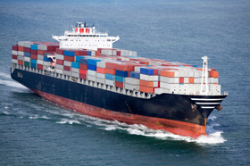

Slide 6
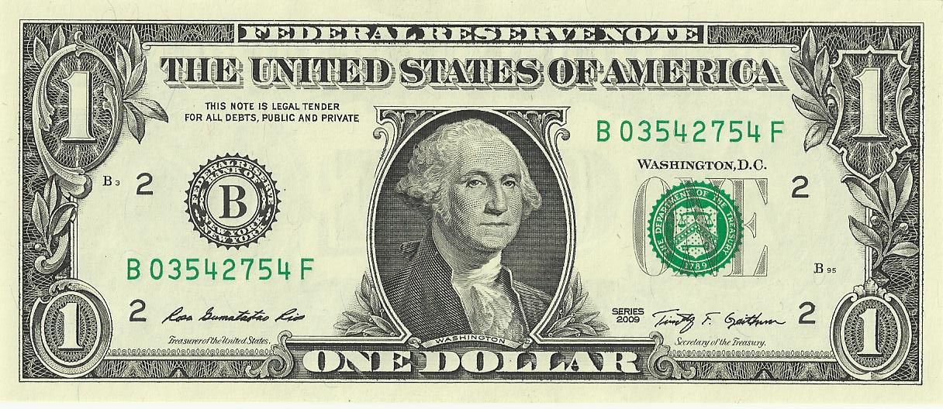
Value of dollar
The dollar is the highest weighted currency. In the case study, Mr. Sanchez sold his product when the country was in a recession. This means that he sold a lot of his product to make a profit; this includes the fact that the dollar was weak at the time. When the economy’s condition started going back to the way it was, the product became more expensive, the value of the dollar started to go back up, and Mr. Sanchez could not produce enough goods to sell in the U.S. alone. Knowing the importance of dollar value in comparison to other countries (or in a more global context) is important because our global economy is in balance because of this uneven value of currency around the world. Why does $1 in the U.S. cost 61 rupees in India? If the world were to just use the dollar, there would be inflation. We would be printing mass amounts of money just to go around.

